Slide 1
VS FEATURES

Slide 2
Objective
Understand and work with Toolbars and Docking
Using intellisense
Navigate back and forth, go to definition
Error and output view, snippets
Refactoring code - Surround With and Extract Options
How to connect debugger to a running application
Recap of various debugging options

Slide 3
VISUAL STUDIO FEATURES

Slide 4
Menus and Toolbars
MENUBAR
TOOLBAR

Slide 5
Customizing Toolbar and Menu
Adding, removing, or moving a menu on the menu bar
Adding, removing, or moving a toolbar
Customizing a menu or a toolbar
Add Tools in Toolbar

Slide 6
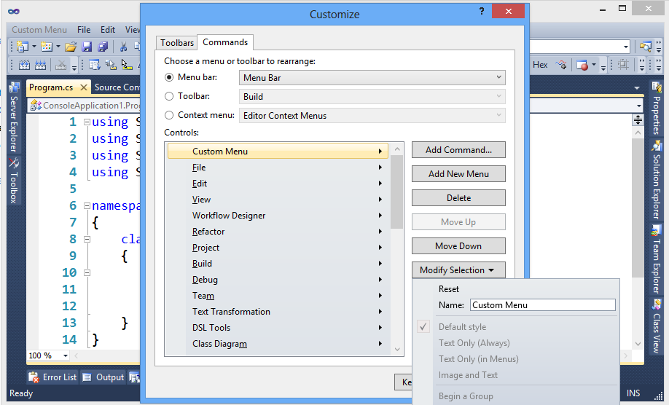
Adding, Removing or Moving a Menu on the Menu bar
Notes:
On the menu bar, choose Tools, Customize.
The Customize dialog box opens.
On the Commands tab, leave the Menu bar option button selected, leave Menu Bar selected in the list next to that option, and then perform one of the following sets of steps:
To add a menu, choose the Add New Menu button, choose the Modify Selection button, and then name the menu that you want to add.
To remove a menu, choose it in the Controls list, and then choose the Delete button.
To move a menu within the menu bar, choose the menu in the Controls list, and then choose the Move Up or Move Down button.

Slide 7
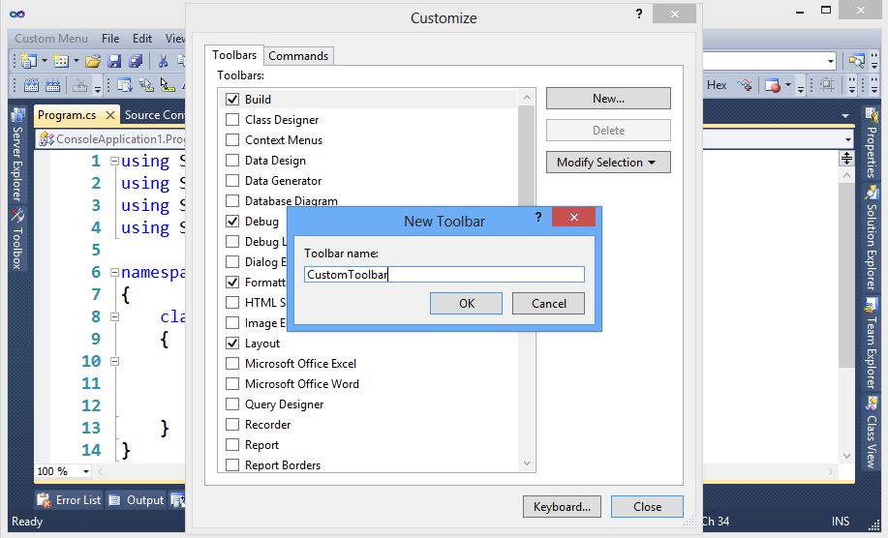
Adding, Removing or Moving a Menu on the Menu bar
Notes:
On the menu bar, choose Tools, Customize.
The Customize dialog box opens.
On the Toolbar tab, perform one of the following sets of steps:
To add a toolbar, choose the New button, specify a name for the toolbar that you want to add, and then choose the OK button.
To remove a custom toolbar, choose it in the Toolbars list, and then choose the Delete button.
To move a toolbar to a different docking location, choose it in the Toolbars list, choose the Modify Selection button, and then choose a location in the list that appears.
You can also drag a toolbar by its left edge to move it anywhere in the main docking area.

Slide 8
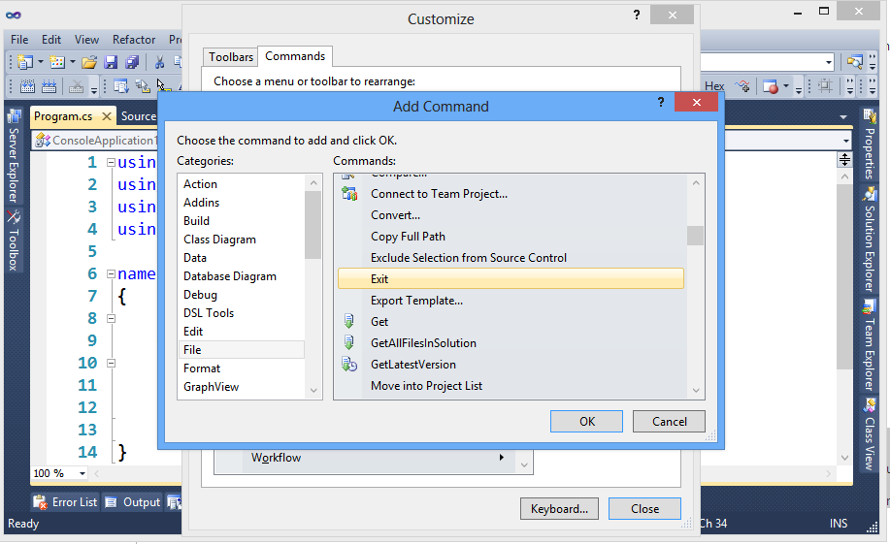
Customizing a Menu or a Tool bar
Notes:
On the menu bar, choose Tools, Customize.
The Customize dialog box opens.
On the Commands tab, choose the option button for the type of element that you want to customize.
In the list for that type of element, choose the menu or toolbar that you want to customize, and then perform one of the following sets of steps:
To add a command, choose the Add Command button.
In the Add Command dialog box, choose an item in the Categories list, choose an item in the Commands list, and then choose the OKbutton.
To delete a command, choose it in the Controls list, and then choose the Delete button.
To reorder commands, choose a command in the Controls list, and then choose the Move Up or Move Down button.
To separate commands into groups, choose a command in the Controls list, choose the Modify Selection button, and then choose Begin a Group in the menu that appears.

Slide 9
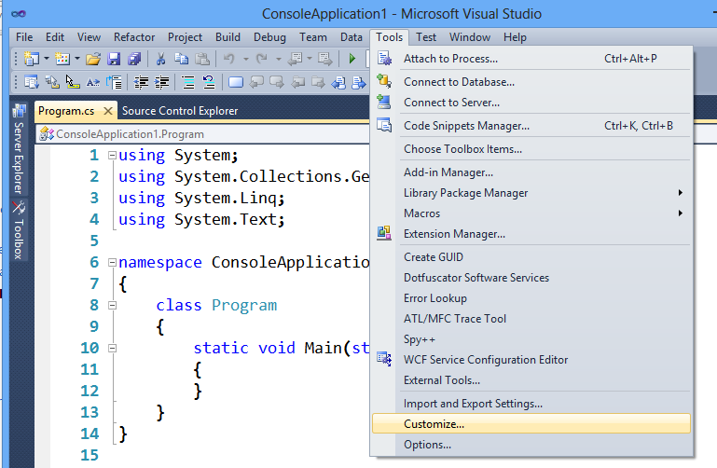
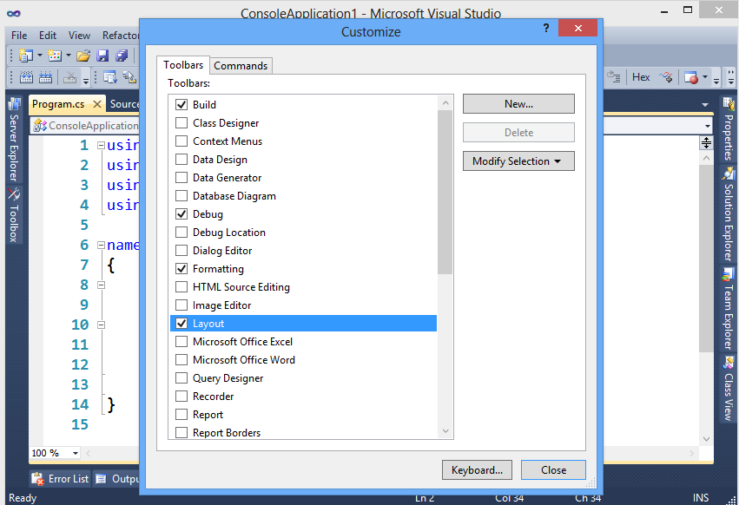
Add Tools in Toolbar
Notes:
To create a toolbar
On the Tools menu, click Customize.
In the Customize dialog box, on the Toolbars tab, select all the tools that you require
Click on close

Slide 10
Arrange and Dock Windows
The integrated development environment (IDE) contains two kinds of windows, tool windows and document windows.
You can adjust the viewing and editing space for code, depending on how you arrange the windows in the IDE.
The following options are just some of the ways that windows can be arranged:
Tab-dock windows to the editing frame.
Dock tool windows to the edge of a frame in the IDE.
Float windows over or outside the IDE.
Minimize tool windows along the edge of the IDE.
etc.

Slide 11
Floating Windows
Any tool window or document window can be undocked from the IDE and moved anywhere on the desktop.
If two related document windows are displayed at the same time, both are updated when the content is edited in either.
To position a tool window or document window outside the IDE
Drag the window to the location you want.
To return a tool window or document window to its most recent docked location
Press CTRL while you double-click the title bar of the window.

Slide 12
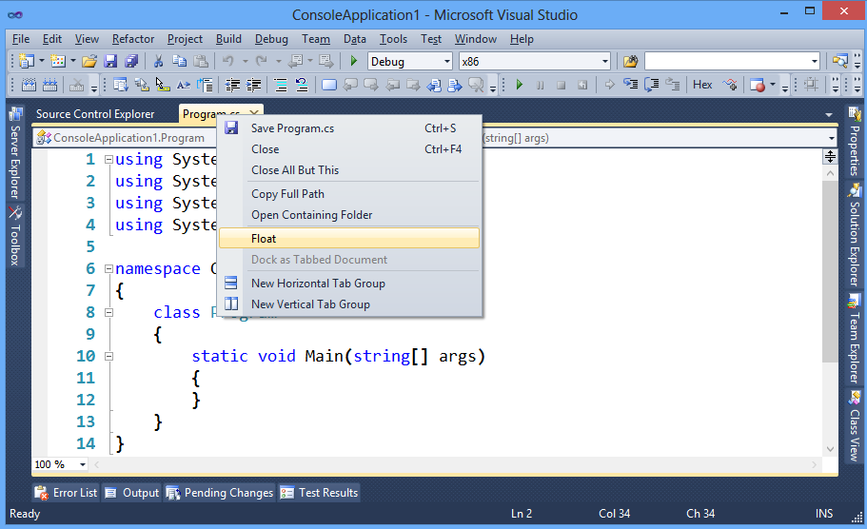
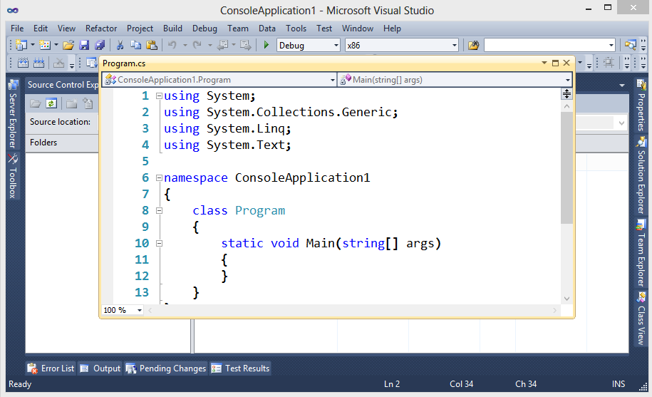
Floating Window

Slide 13
Docking Windows
By default, designer windows and editor windows that display documents are arranged on tabbed panes in the editing frame of the IDE.
Tool windows can be fastened to one side of a frame in the IDE.
A guide diamond appears when you drag a tool window to another location in the IDE.
The guide diamond helps you re-dock the window on one of the four sides of the IDE, or to a location in the editing frame.
Notes:
Note:
To dock tool windows and document windows
Click the tool window or document window you want to dock.
Drag the window toward the middle of the IDE.
A guide diamond appears. The four arrows of the diamond point toward the four sides of the editing pane. If the window is a tool window, an additional four arrows point to the four edges of the IDE.
When the window you are dragging reaches the location where you want to dock it, move the pointer over the corresponding portion of the guide diamond. The designated area is shaded.
To dock the window in the position indicated, release the mouse button.
For example, if Solution Explorer is docked on the right edge of the IDE and you want to dock it on the left edge, drag Solution Explorer toward the middle of the IDE, move the pointer over the far left arrow of the guide diamond, and then release the mouse button.
Alternatively, you can dock a tool window to a portion of one of the side walls of the IDE by dragging it to the side until you see a secondary guide diamond. Click one of the four arrows to dock the tool window to that portion of the side wall.

Slide 14
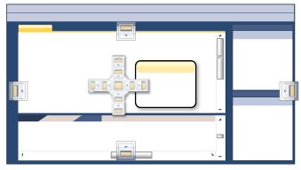
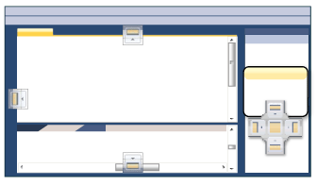
Docking Windows

Slide 15
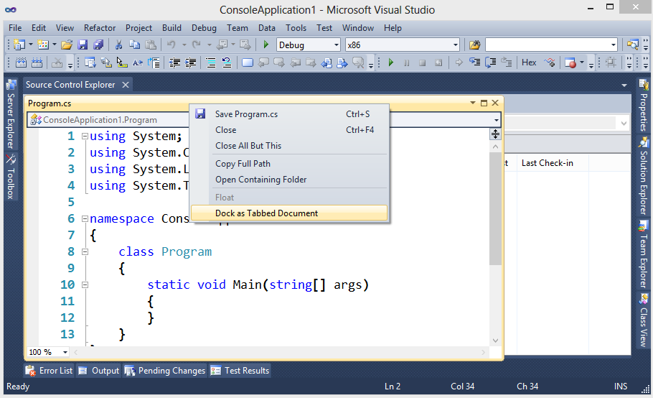
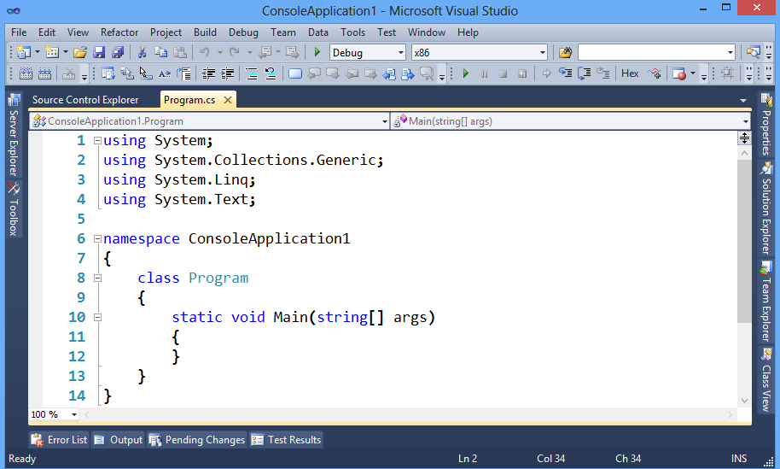
Docked Window

Slide 16
Minimizing Tool Windows
Tool windows, the names of which appear on the View menu, support a feature named Auto Hide. Auto Hide causes a window to slide out of the way when you use a different window. When a window is auto-hidden, its name and icon are displayed on a tab at the edge of the IDE. To use the window again, move the pointer over the tab so that it slides back into view.
To turn on Auto Hide
Click the window you want to hide.
On the Window menu, click Auto Hide.
As an alternative, you can click the pushpin icon on the title bar of the window.
To turn off Auto Hide
Click the window you want to keep visible.
On the Window menu, click Auto Hide to clear the check mark.
As an alternative, you can click the pushpin icon on the title bar of the window.

Slide 17
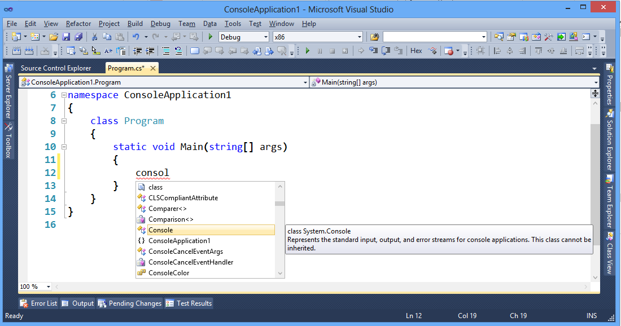
Intellisense
IntelliSense provides an array of features that make language references easy to access. When you are coding, you do not have to leave the Code Editor or the Immediate Mode command window to perform searches on language elements. You can keep your context, find the information that you need, insert language elements directly into your code, and even have IntelliSense complete your typing for you.
Notes:
Press Ctrl + Space bar to get the intellisense

Slide 18
Navigate Back and Forth, Go To Definition
You can use following options to search for objects, definitions, or references (symbols) in a solution.
Object Browser,
Navigate To,
Find Symbol, or
Go to Definition

Slide 19
Object Browser
When you type a search string in the Search box in Object Browser, just the current browsing scope is searched. Use the Browse list to select a browsing scope
To search for symbols by using a search string in Object Browser
In Object Browser, in the Browse list, select a browsing scope.
In the Search box, type all or part of a symbol name to search for, or select one from the drop-down list.
Click Search.
The objects pane displays just those symbol names in the browsing scope that include the search string. The string is highlighted in every match.
To clear the results
In Object Browser, click the Clear Search button on the toolbar.
The objects pane now displays all the objects in the current browsing scope.

Slide 20
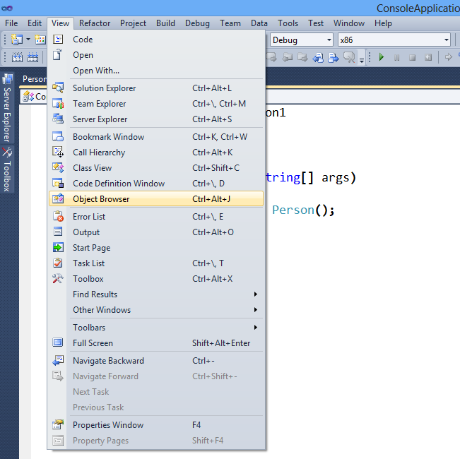
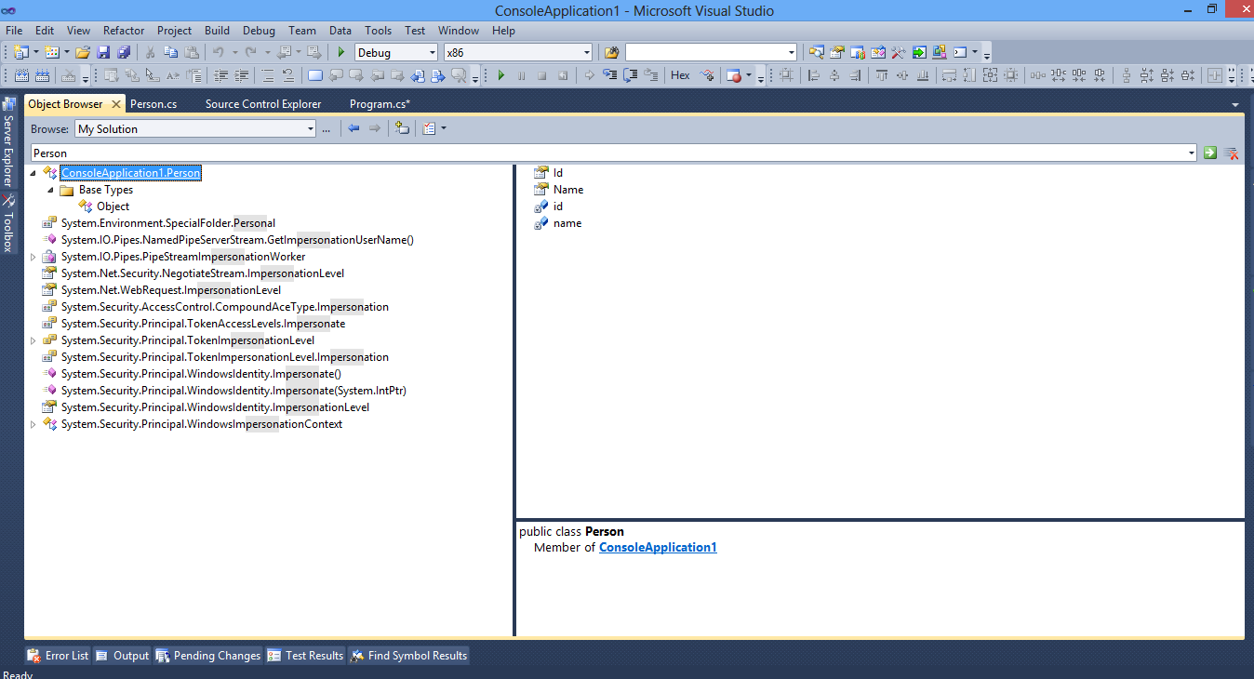
Object Broswer
In the Object Browser, you can type a search string to filter the names of the symbols that are displayed in the objects pane for the current browsing scope.

Slide 21
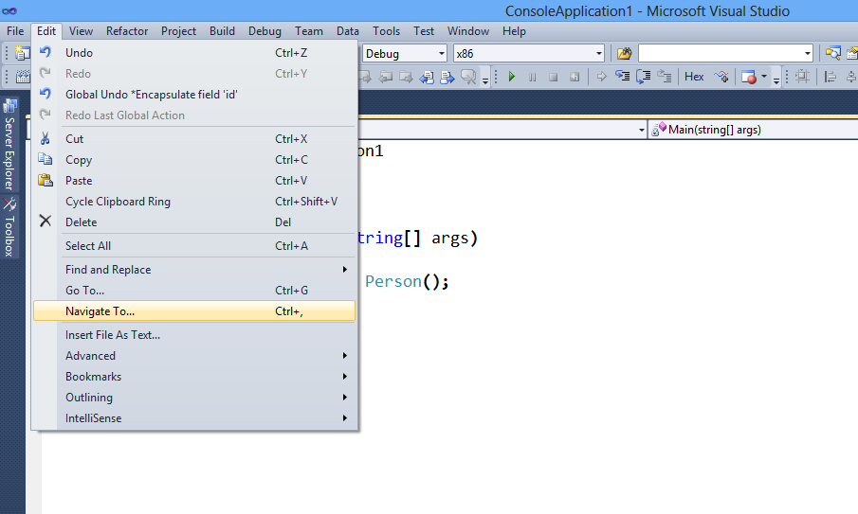
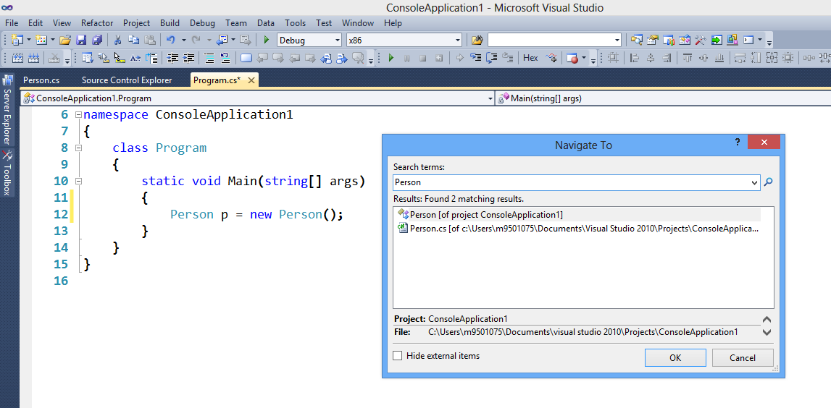
Using Navigate To
Navigate To lets you find and navigate to a specific location in the solution, or explore elements in the solution. It helps you pick a good set of matching results from a query.
Notes:
Note:
To search for symbols or files in Navigate To
On the Edit menu, click Navigate To.
In the upper box, type a search string.
Notice that results are displayed in the lower box as you type, and change as you type more. For example, if you type Click, then all symbol names that contain "Click" are displayed; however, if you add a space and the letter E, then the list is filtered to display just symbols that include "Click" and "E" (the space is treated as an and relationship).
The search results may include symbol definitions and file names in the solution, but does not include namespaces or local variables.
A search string can have multiple search terms, which must be separated by spaces. If a search term has an uppercase letter, the search for that term is case-sensitive; otherwise, the search is case-insensitive. File names are always case-insensitive for the first characters of the file name.

Slide 22
Using Find Symbol
Use the Find Symbol tab of the Find and Replace window to locate lines in your project code where a symbol is defined, referenced, or used.
In particular, Find Symbol is useful as follows:
Searching for the definition of a symbol or discovering multiple definitions of a symbol.
Searching for references to a symbol and instances where it is used in your code.
Exploring object hierarchies in referenced and external components so that you can learn about their functionality.
Using Find Symbol differs from finding text, as follows:
Find Symbol lets you limit the search scope to include only symbols.
Indicates any available definitions of the symbol and references to it in the Find Symbol Results window.
Lets you search in external components for which you do not have the source code.

Slide 23
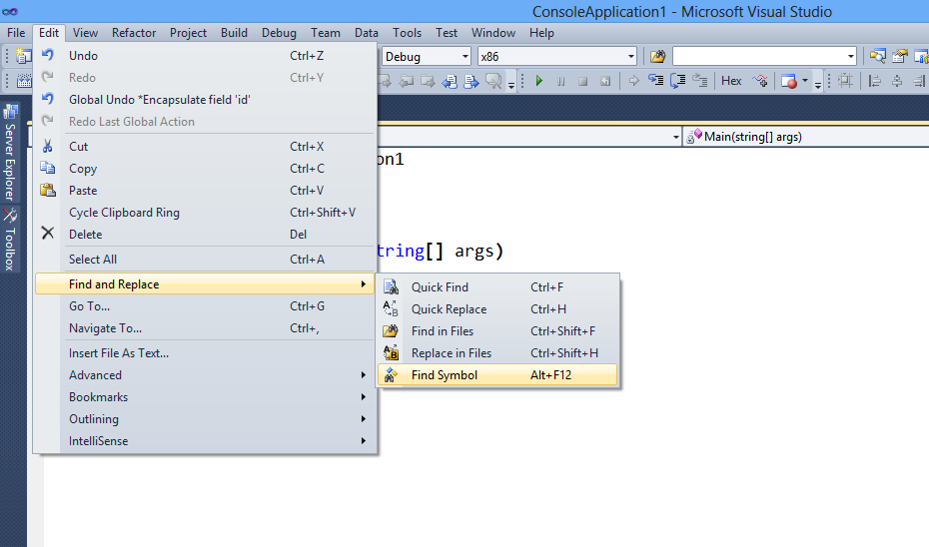
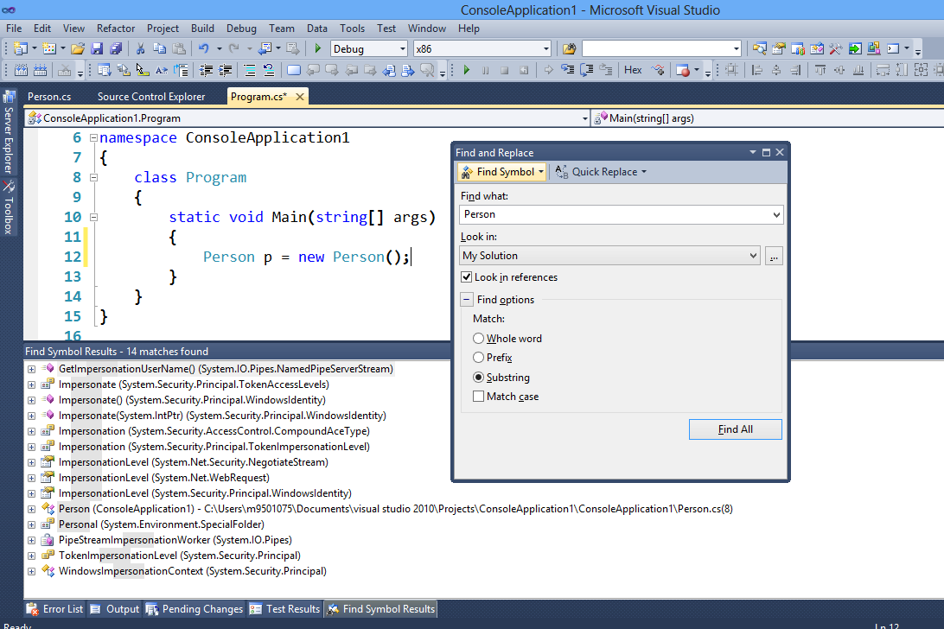
Using Find Symbol
Notes:
Go to Edit menu
Select Find and Replace
Click on Find Symbol
When Find and Replace dialog box appears, type what you would like to find
Click on Find All button
Result will be displayed in “Find Symbol Results” Window

Slide 24
Navigate to a Definition
In the editor, when you want to search for the original definition of a code element, right-click the element and then click Go to Definition.
You can search on elements such as members, types, variables, locals, and so forth.
Go to Definition uses compiler information to locate and display the original definition, even if your code uses overloads or type inferences, provided that the location is available to Visual Studio.
To search for the definition of a code element
In the editor, right-click the code element for which you want to find the definition, and then click Go To Definition.
The module in which the element is originally defined, if it is available, is displayed on a new tab in the editor. If the definition is not available, an error message is displayed.

Slide 25
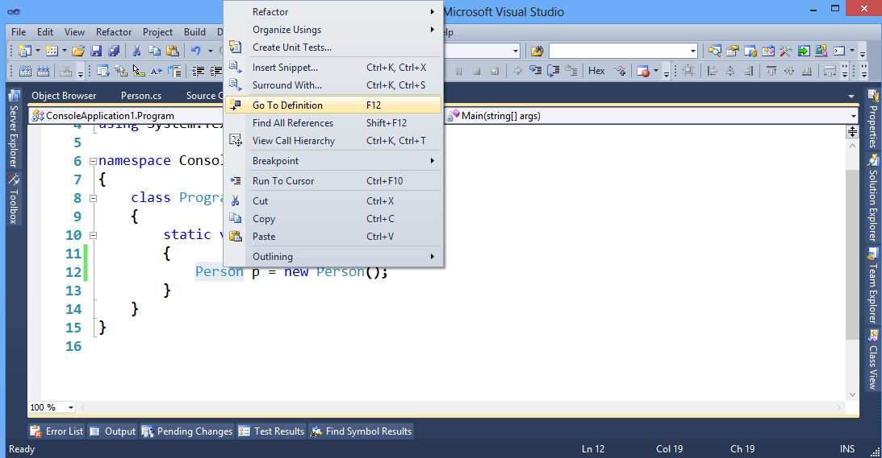
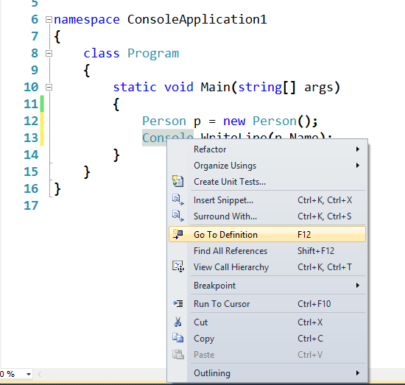
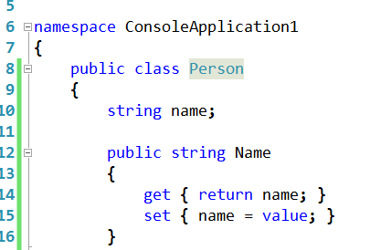
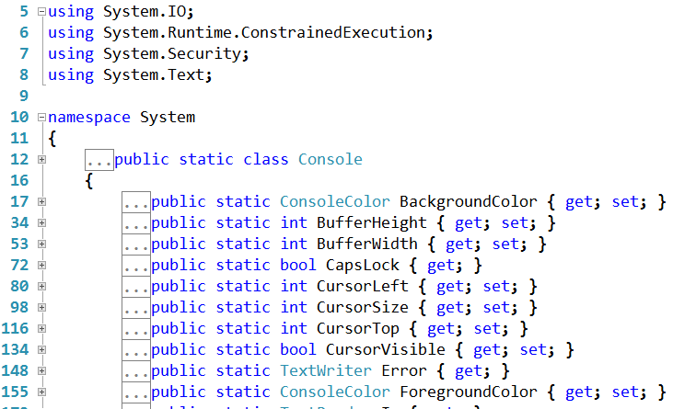
Using Go to Definition
Using go to Definition for Person class, whose source code is available
Clicking on Go to Definition for “Console” class leads to its metadata, since its source code is unavailable
Notes:
Right click on the type and select Go to Definition
If the source code is available, then it will display the source code, otherwise it will display metadata of the type

Slide 26
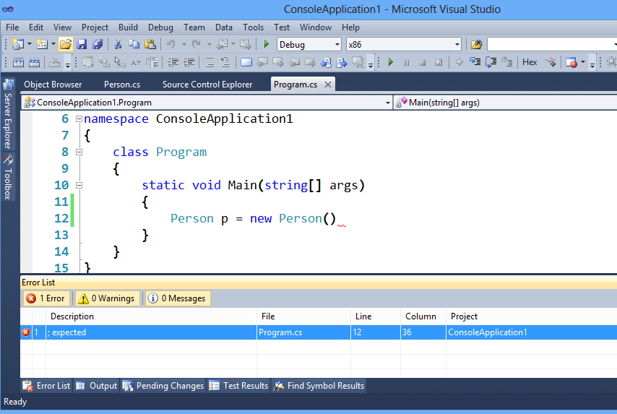
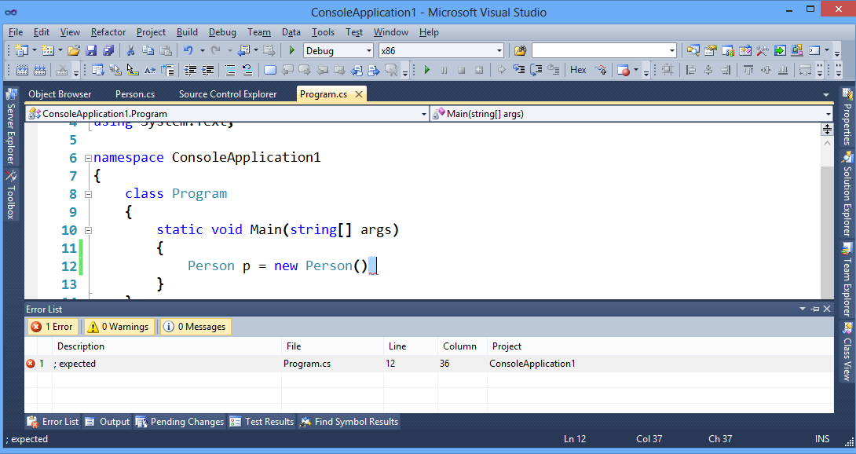
Error List
Error List window is displaying a syntactical error
Double clicking on the line in error list window, displaying a syntactical error, will lead to the line
Notes:
You can go to View>ErrorList to get the error list window

Slide 27
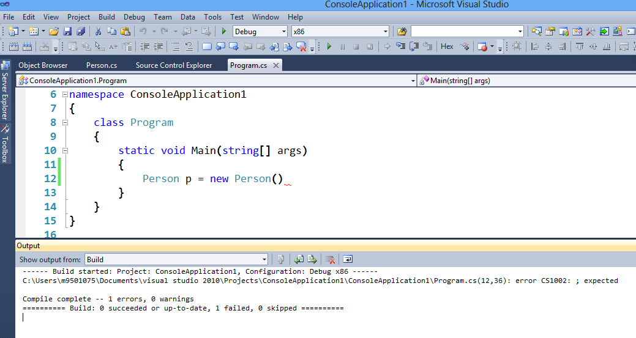
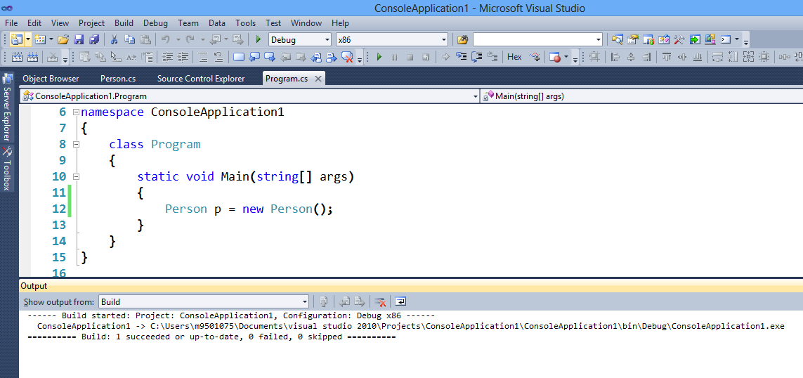
Output View
Output view is showing that application compilation has failed
Output view is showing that application compilation has succeeded
Notes:
You can go to View>output to get the Output window

Slide 28
Refactoring
Refactoring is the process of improving your code after it has been written by changing the internal structure of the code without changing the external behavior of the code.
Visual C# provides the following refactoring commands on the Refactoring menu:
Extract Method Refactoring (C#)
Rename Refactoring (C#)
Encapsulate Field Refactoring (C#)
Extract Interface Refactoring (C#)
Remove Parameters Refactoring (C#)
Reorder Parameters Refactoring (C#)

Slide 29
Extract Method Refactoring
Extract Method is a refactoring operation that provides an easy way to create a new method from a code fragment in an existing member.
Extract Method has the following benefits:
Encourages best coding practices by emphasizing discrete, reusable methods.
Encourages self-documenting code through good organization.
When descriptive names are used, high-level methods can read more like a series of comments.
Encourages the creation of finer-grained methods to simplify overriding.
Reduces code duplication

Slide 30
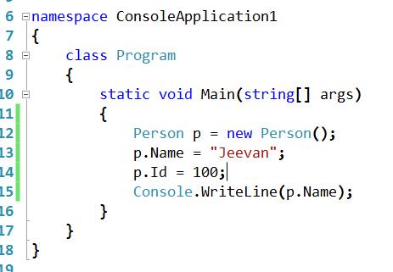
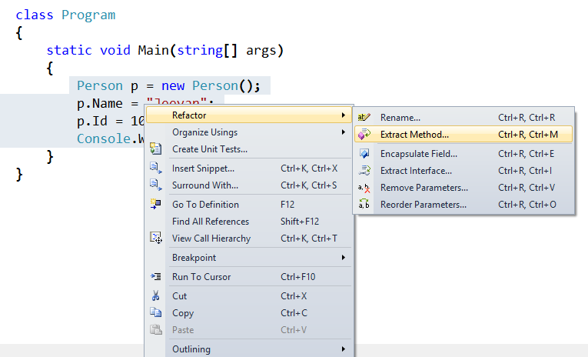
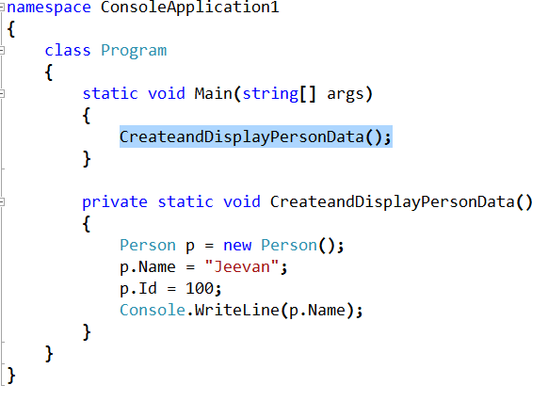
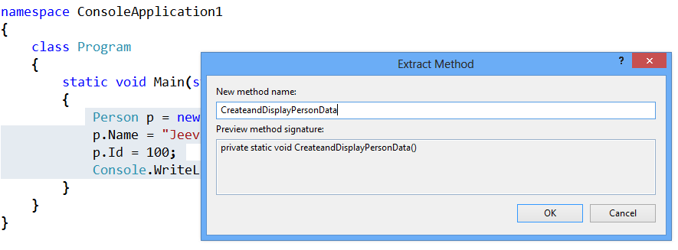
Extract Method Refactoring
Notes:
Select the code fragment you want to extract:
On the Refactor menu, click Extract Method.
The Extract Method dialog box appears.
Alternatively, you can also type the keyboard shortcut CTRL+R, M to display the Extract Method dialog box.
You can also right-click the selected code, point to Refactor, and then click Extract Method to display the Extract Method dialog box.
Specify a name for the new method in the New Method Name box.
A preview of the new method signature displays under Preview Method Signature.
Click OK.

Slide 31
Rename Refactoring
Rename is a refactoring feature in the Visual Studio integrated development environment (IDE) that provides an easy way to rename identifiers for code symbols such as
fields,
local variables,
methods,
namespaces,
properties, and
types.
Rename can be used to change the names in comments and in strings and to change the declarations and calls of an identifier.

Slide 32
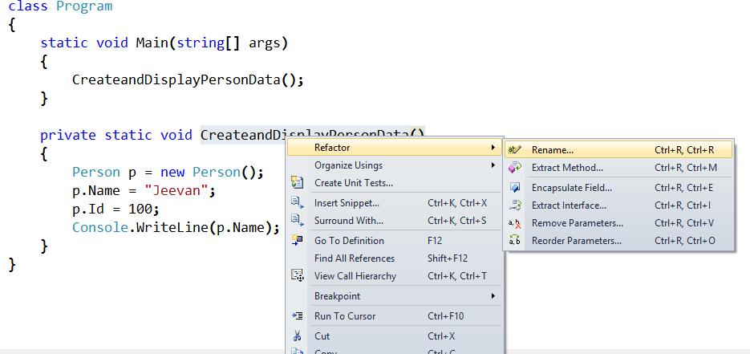
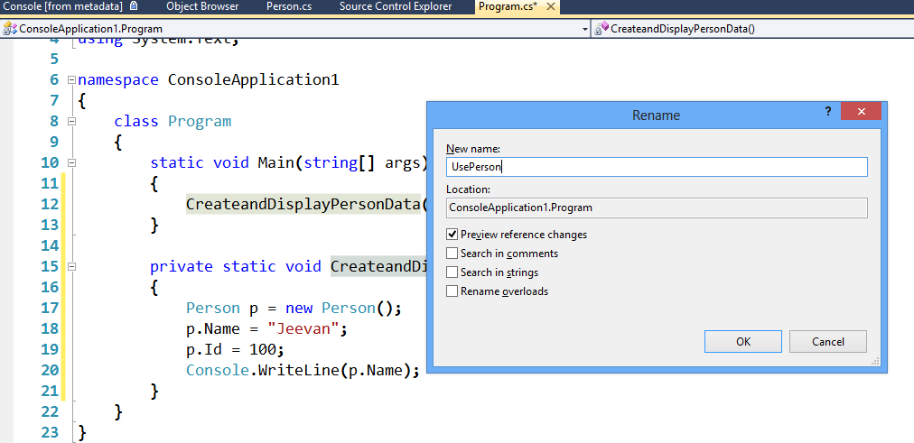
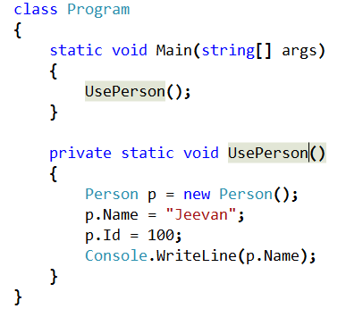
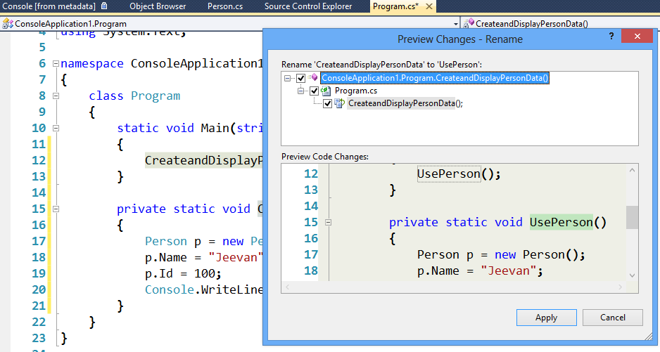
Rename Refactoring
Notes:
Place the cursor on method name that you would like to change, either in the method declaration or the method call.
From the Refactor menu, select Rename. The Rename dialog box appears.
You can also right-click the cursor, point to Refactor on the context menu, and then click Rename to display the Rename dialog box.
In the New Name field, type new method name.
Select the Search in Comments check box.
Click OK.
In the Preview Changes dialog box, click Apply.

Slide 33
Encapsulate Field Refactoring
The Encapsulate Field refactoring operation enables you to quickly create a property from an existing field, and then seamlessly update your code with references to the new property.
When a field is public, other objects have direct access to that field and can modify it, undetected by the object that owns that field.
By using properties to encapsulate that field, you can disallow direct access to fields.
To create the new property, the Encapsulate Field operation changes the access modifier for the field that you want to encapsulate to private, and then generates get and set accessors for that field.
In some cases, only a get accessor is generated, such as when the field is declared read-only.

Slide 34
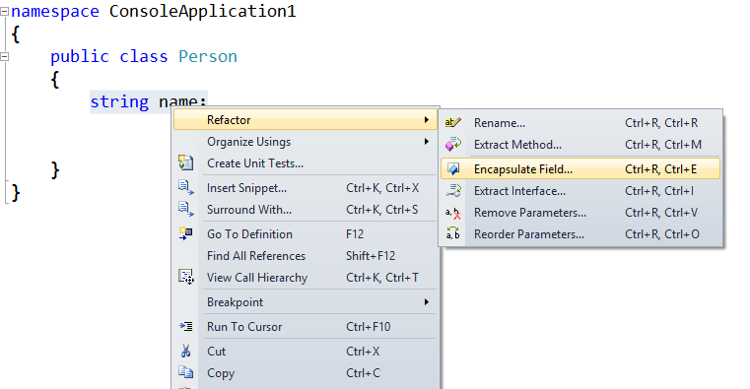
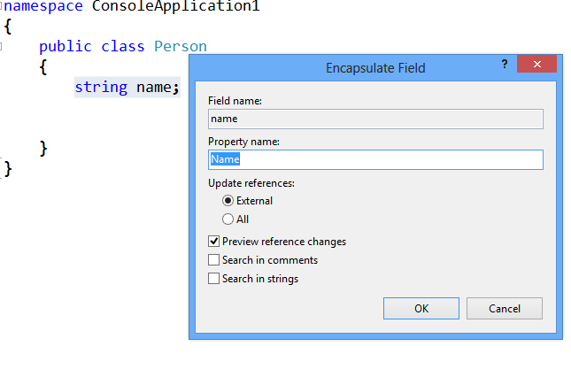
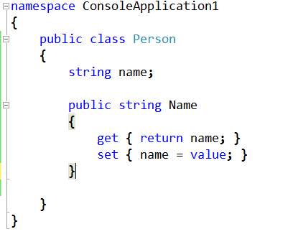
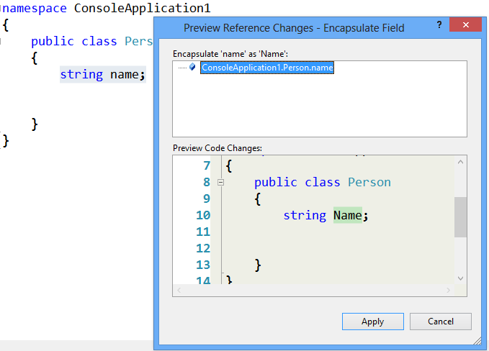
Encapsulate Field Refactoring
Notes:
In the Code Editor, place the cursor in the declaration, on the name of the field that you want to encapsulate.
On the Refactor menu, click Encapsulate Field.
The Encapsulate Field dialog box appears.
You can also type the keyboard shortcut CTRL+R, E to display the Encapsulate Field dialog box.
You can also right-click the cursor, point to Refactor, and then click Encapsulate Field to display the Encapsulate Field dialog box.
Specify settings.
Press ENTER, or click the OK button.
If you selected the Preview reference changes option, then the Preview Reference Changes window opens. Click the Apply button.
The property with, get and set accessor code is added in your code

Slide 35
Extract Interface Refactoring
Extract Interface is a refactoring operation that provides an easy way to create a new interface with members that originate from an existing class, structure, or interface.
When several clients use the same subset of members from a class, structure, or interface, or when multiple classes, structs, or interfaces have a subset of members in common, it can be useful to embody the subset of members in an interface.
Extract Interface generates an interface in a new file and positions the cursor at the beginning of the new file.
You can specify which members to extract into the new interface, the name of the new interface, and the name of the generated file using the Extract Interface dialog box.

Slide 36
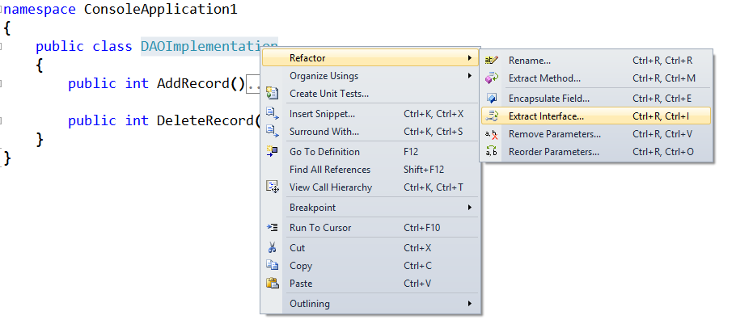
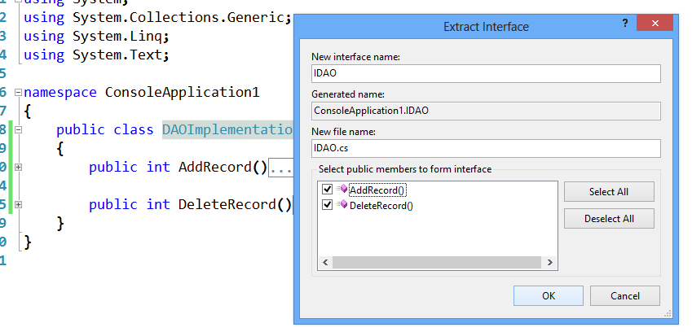
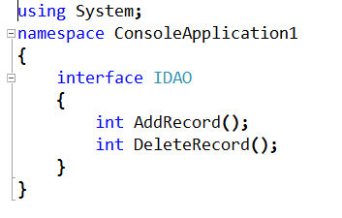
Extract Interface Refactoring
Notes:
With the cursor positioned on class name, click Extract Interface on the Refactor menu.
The Extract Interface dialog box appears.
You can also type the keyboard shortcut CTRL+R, I to display the Extract Interface dialog box.
You can also right-click the mouse, point to Refactor, and then click Extract Interface to display the Extract Interface dialog box.
Click Select All.
Click OK.
A new file, with an interface, will be added in the project

Slide 37
Remove Parameters Refactoring
Remove Parameters is a refactoring operation that provides an easy way to remove parameters from methods, indexers, or delegates.
Remove Parameters changes the declaration; at any locations where the member is called, the parameter is removed to reflect the new declaration.
You perform the Remove Parameters operation by first positioning the cursor on a method, indexer, or delegate.
While the cursor is in position, to invoke the Remove Parameters operation, click the Refactor menu, press the keyboard shortcut, or select the command from the shortcut menu.

Slide 38
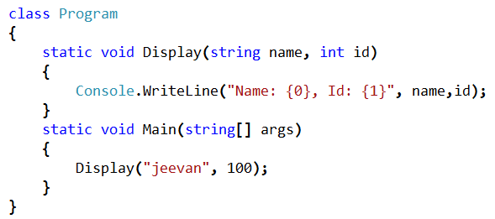
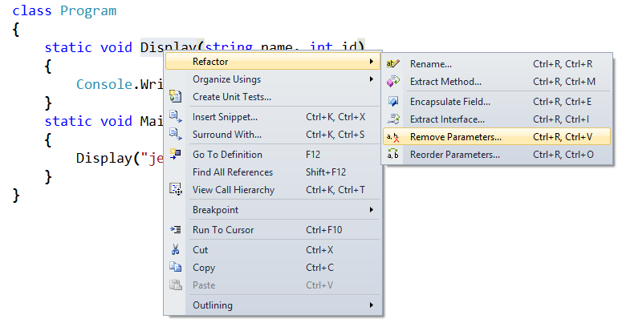
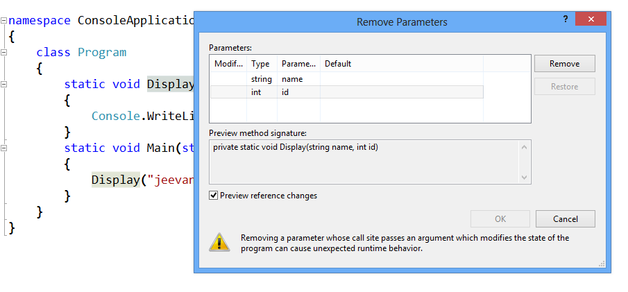
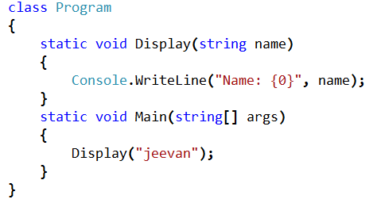
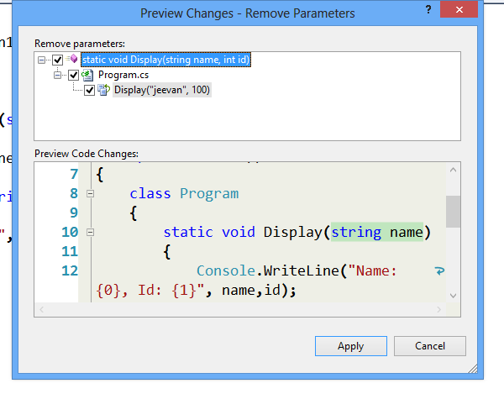
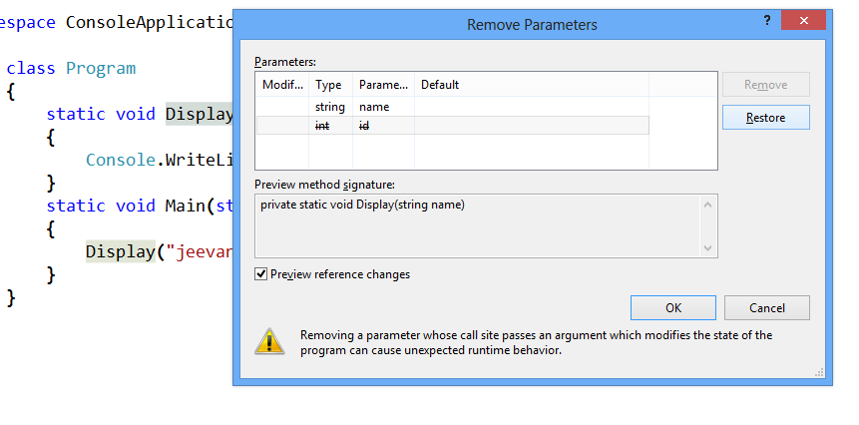
Remove Parameters Refactoring
Notes:
Place the cursor on method , either in the method declaration or the method call.
From the Refactor menu, select Remove Parameters to display the Remove Parameters dialog box.
You can also type the keyboard shortcut CTRL+R, V to display the Remove Parameters dialog box.
You can also right-click the cursor, point to Refactor, and then click Remove Parameters to display the Remove Parameters dialog box.
Using the Parameters field, position the cursor on a field, and then click Remove.
Click OK.
In the Preview Changes — Remove Parameters dialog box, click Apply.

Slide 39
Reorder Parameters Refactoring
Reorder Parameters is refactoring operation that provides an easy way to change the order of the parameters for methods, indexers, and delegates.
Reorder Parameters changes the declaration, and at any locations where the member is called, the parameters are rearranged to reflect the new order.
To perform the Reorder Parameters operation, put the cursor on or next to a method, indexer, or delegate.
When the cursor is in position, invoke the Reorder Parameters operation by pressing the keyboard shortcut, or by clicking the command from the shortcut menu.

Slide 40
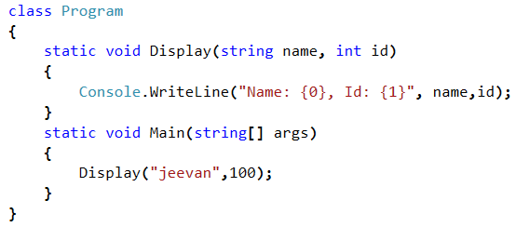
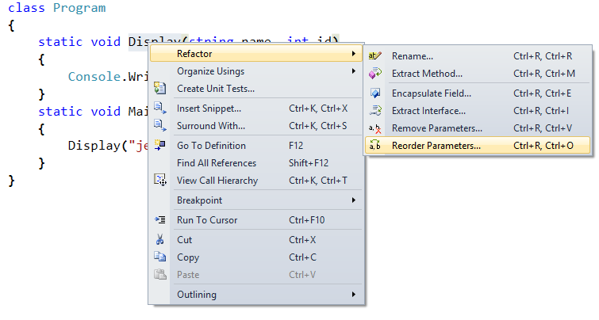
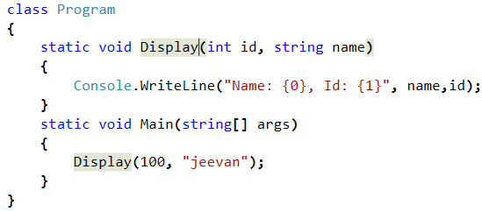


Reorder Parameters Refactoring
Notes:
Place the cursor on method, whose parameters you would like to rearrange, either in the method declaration or the method call.
On the Refactor menu, click Reorder Parameters.
The Reorder Parameters dialog box appears.
In the Reorder Parameters dialog box, select a parameter in the Parameters list, and then click the down/up button.
In the Reorder Parameters dialog box, click OK.
If the Preview reference changes option is selected in the Reorder Parameters dialog box, the Preview Changes - Reorder Parameters dialog box will appear. It provides a preview of the changes in the parameter list for method in both the signature and the method call.
If the Preview Changes - Reorder Parameters dialog box appears, click Apply.
Check that, the method declaration and all the method call sites for the method, are updated.

Slide 41
Code Snippet
A code snippet is a block of reusable code that you can insert where you need it in your code.
Snippets can be simple or more complex—for example, blocks such as try-finally and if-else are commonly used, but you could also use snippets to insert entire classes or methods.
Visual Studio enables two kinds of code snippet:
insertion snippets, which are added at a specified insertion point,
surround-with snippets (C# and C++ only), which are added around a selected block of code.
Notes:
Note:
To insert an insertion snippet in your code, put the cursor where you want the snippet to appear, open the shortcut menu, choose Insert Snippet, and then navigate to the snippet you want, select it, and press the Tab key. If you already know the name of the snippet, just type its name at the cursor and then press Tab+Tab.

Slide 42






Code Snippet-Some Examples
Code snippet for “for” loop
Code snippet for “if” loop
Write your code
Write your code

Slide 43
Surround With
Surround-with code snippets are available three ways: through a keyboard shortcut, through the Edit menu, and through the context menu.
To use surround-with code snippets through keyboard shortcut
In the Visual Studio IDE, open the file that you intend to edit.
In the Code Editor, select text to surround.
Type CTRL+K, CTRL+S.
Select the code snippet from the code snippet list using the mouse, or by typing the name of the code snippet and pressing TAB or ENTER.
To use surround-with code snippets through the Edit menu
In the Visual Studio IDE, open the file that you intend to edit.
In the Code Editor, select text to surround.
From the Edit menu, select IntelliSense and then select the Surround With command.
Select the code snippet from the code snippet inserter and then press TAB or ENTER.
Alternatively, you can type the name of the code snippet, and then press TAB or ENTER.
To use surround-with code snippets through the context menu
In the Visual Studio IDE, open the file that you intend to edit.
In the Code Editor, select text to surround.
Right-click the selected text and then select the Surround With command from the context menu.
Select the code snippet from the code snippet inserter and then press TAB or ENTER.
Alternatively, you can type the name of the code snippet, and then press TAB or ENTER.

Slide 44




Surround With - Example
Notes:
Note:
Select the line “Console.WriteLine("I: {0}", i);”
Right click and from context menu select “Surround With”
Select “for” from the intellisense
Press tab and get the code snippet for “for” loop which will surround the line
Complete your code

Slide 45
Connect a Debugger to a Running Application
The Visual Studio debugger has the ability to attach to a process that is running outside of Visual Studio. You can use this attach capability to do the following:
Debug an application that was not created in Visual Studio.
Debug multiple processes simultaneously. You can also debug multiple processes by starting multiple projects within a single solution.
Debug a process running on a remote computer.
Debug a DLL that runs in a separate process that cannot easily be started from Visual Studio, for example, a service or an ISAPI DLL running with Internet Information Services.
Start the debugger automatically when a process crashes while running outside of Visual Studio. This is Just-In-Time debugging.

Slide 46



Connect a Debugger to a Running Application
Notes:
Note:
The application should run.
1. On the Debug menu, select Attach to Process.
12 In the Attach to Process dialog box, find the program that you want to attach to from the Available Processes list.
Note:
If the program that you want to debug is running on another computer, use the Qualifier list box to select or specify the remote computer. If the process is running under a different user account, select the Show processes from all users check box.
If you are connected through Remote Desktop Connection, select the Show processes in all sessions check box.
3. In the Attach to box, make sure that the type of code you will debug is listed. The default Automatic setting tries to determine what type of code you want to debug.
If the automatic setting is not appropriate:
a. Click Select.
b. In the Select Code Type dialog box, click Debug these code types and select the types to debug.
c. Click OK.
4. Click Attach.
The Available Processes list is displayed automatically when you open the Processes dialog box. Processes can start and stop in the background while the dialog box is open. However, the contents are not always current. You can refresh the list at any time to see the current list of processes by clicking Refresh.

Slide 47
Reference
http://msdn.microsoft.com/en-us/library/3s68z0b3.aspx
http://msdn.microsoft.com/en-us/library/6hf704tz.aspx
http://msdn.microsoft.com/en-us/library/ms165392.aspx
http://msdn.microsoft.com/en-us/library/efc4xwkb(v=vs.100).aspx
http://msdn.microsoft.com/en-us/library/dd465268(v=vs.100).aspx
Notes:
Reference

